Slide 1
House Pricing Regression Analysis
Project description: Analyzing a housing dataset and building a model around it to makwe predictions on housing prices in the future
By: Sakibu Abdulmujeeb
ID: ALT/SOD/023/1147

Slide 2
About the dataset
Ask a home buyer to describe their dream house, and they probably won't begin with the height of the basement ceiling or the proximity to an east-west railroad. But one thing they would definitely be concerned about is the Pricing
With 79 explanatory variables describing (almost) every aspect of residential homes in Ames, Iowa, this project allow me to build a model around the dataset that lets me make predictions on the model in the future

Slide 3
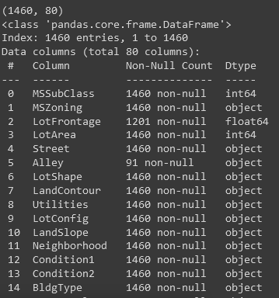
Dataset overview
The dataset has a shape of 1460, 79 (excluding the id column)
There are null value to be found on different areas of the dataset
The columns are a mixture of int64, float64 and object data types.

Slide 4
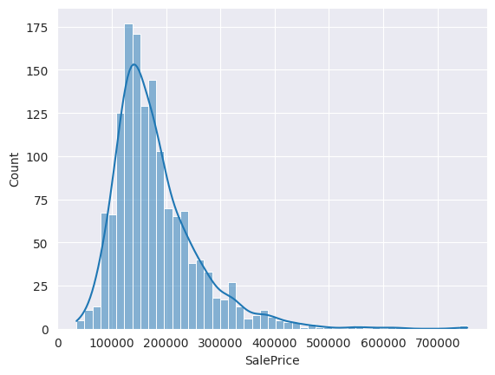
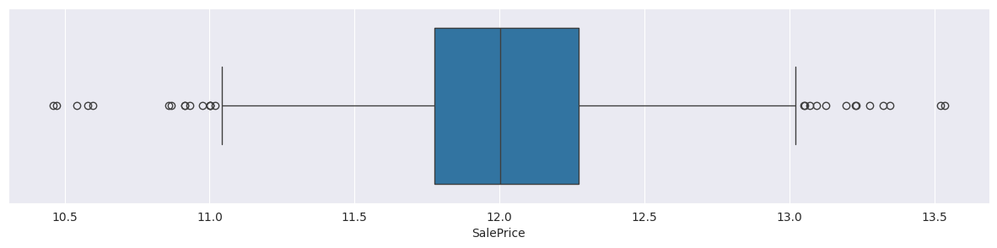
EDA
The sales price are heavily skewed (1.8) Which is bad for building models
Methods were taken to center it to improve the model.
Result presented on the boxplot.

Slide 5
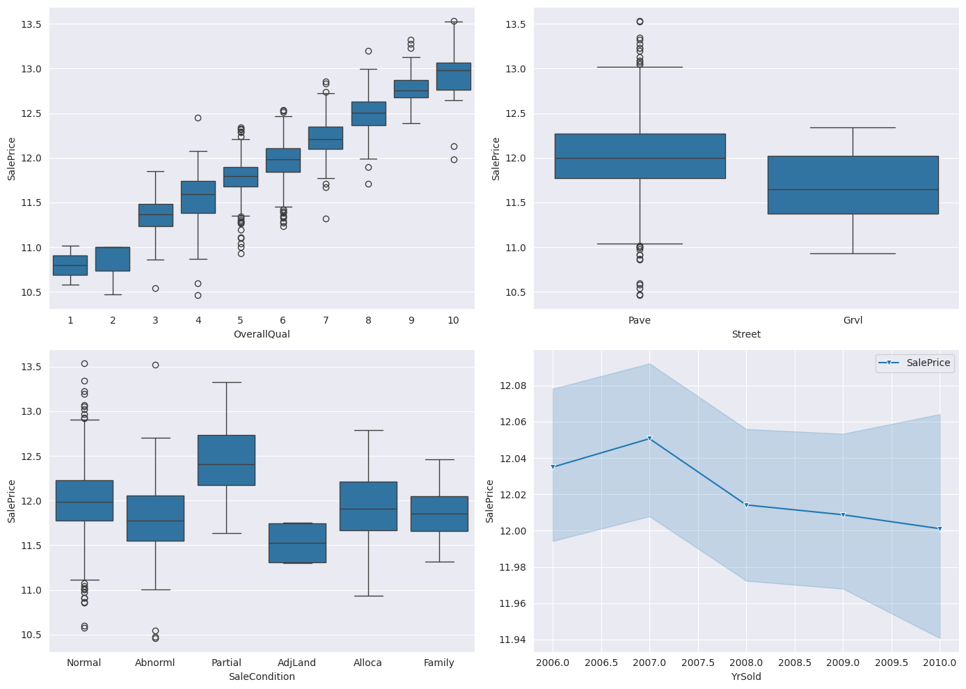
EDA
The Saleprice column was also checked against other columns too and it show a positive correlation for most of them

Slide 6
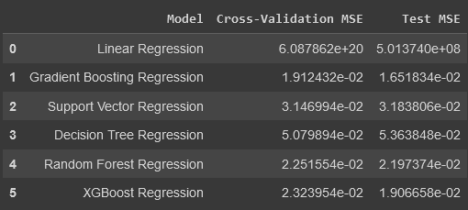
Choosing The Model
6 different models were picked and test upon with Gradient Boosting showing the most promise

Slide 7
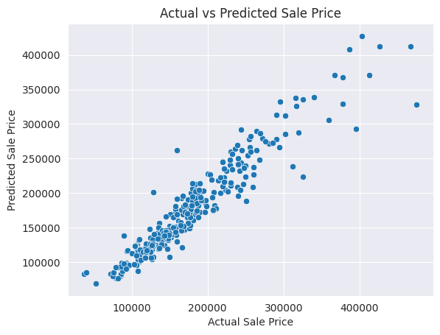
Model Evaluation and conclusion
The model was able to give a good result in the end giving very impressive scores in the RMSE and R2 metrics.
This show not just the accuracy of the model but also the repeatability.

